Slide 1
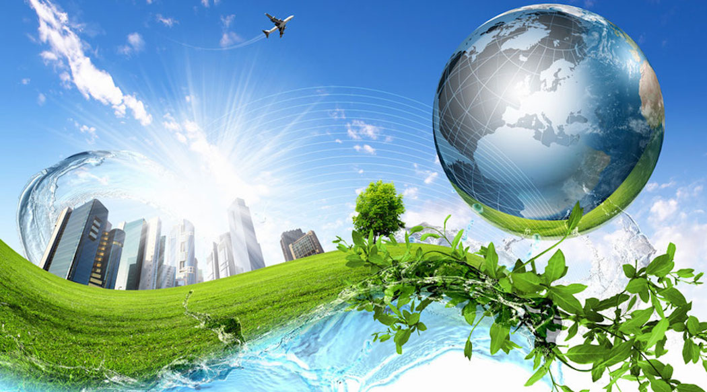
CLIMATE CHANGE
ARE WE MAKING THE WORLD WE WANT ?!!
Notes:
Hello Everyone, Today my presentation is on a very sensitive topic of the climate change in this world. I want to emphasize on the difference between the word that everyone expects the future to be and the world that we are actually working towards.

Slide 2

MASTER SLIDE
The earth that we desire is a green and sustainable future earth.
The earth that we are making through our human activities is an earth that cannot sustain life in the near future.
Carbon emission into the atmosphere causes the green house effect which increases the temperature of the earth leading to global warming.
Notes:
The earth that we desire is a green and sustainable future earth. Right?
But is that what we are building in reality?
The earth that we are making through our human activities is an earth that cannot sustain life in the near future.
Carbon emission into the atmosphere causes the green house effect which increases the temperature of the earth leading to global warming.
We are essentially heading towards the extinction of our earth.

Slide 3
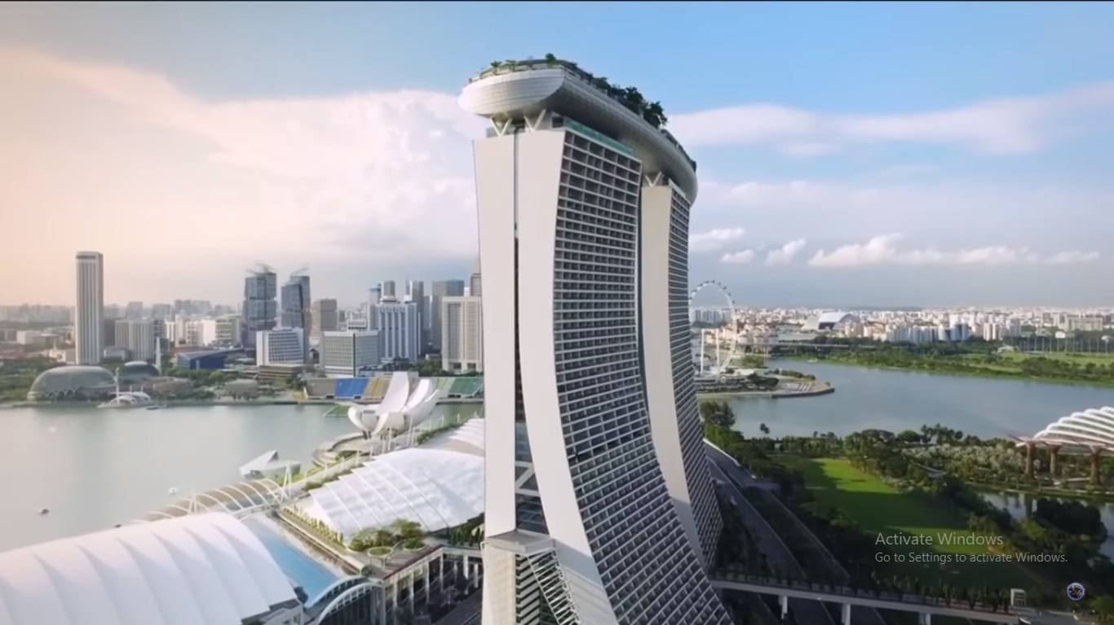
THE EARTH WE WANT https://www.youtube.com/watch?v=ABrjdyavqkI
Notes:
I would like to present to you what I would term the future that everyone would indeed desire for the earth. (https://www.youtube.com/watch?v=ABrjdyavqkI

Slide 4
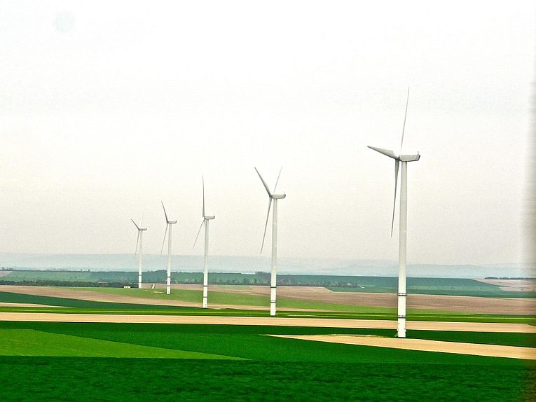
WOULD YOU NOT WANT SUCH A FUTURE?!!
Imagine a world pure of pollutants and full of vibrant nature. A world green with vegetation and economically sustainable. A world where technology and nature exist in harmony. A world described as eco-elegant, with environmental –friendly way of life and economically efficient utility of resources.
Imagine walking down a path elegant and lined with an assortment of nourished flowers and well kept plants. Would than not be a world you desire for you and your future generations? Would you not want such a future?
Notes:
Imagine a world pure of pollutants and full of vibrant nature. A world green with vegetation and economically sustainable. A world where technology and nature exist in harmony. A world described as eco-elegant, with environmental –friendly way of life and economically efficient utility of resources.
Imagine walking down a path elegant and lined with an assortment of nourished flowers and well kept plants. Would than not be a world you desire for you and your future generations? Would you not want such a future?
Would you all agree with me that you would want to live or rather your grand children to live in this earth in the near future.

Slide 5
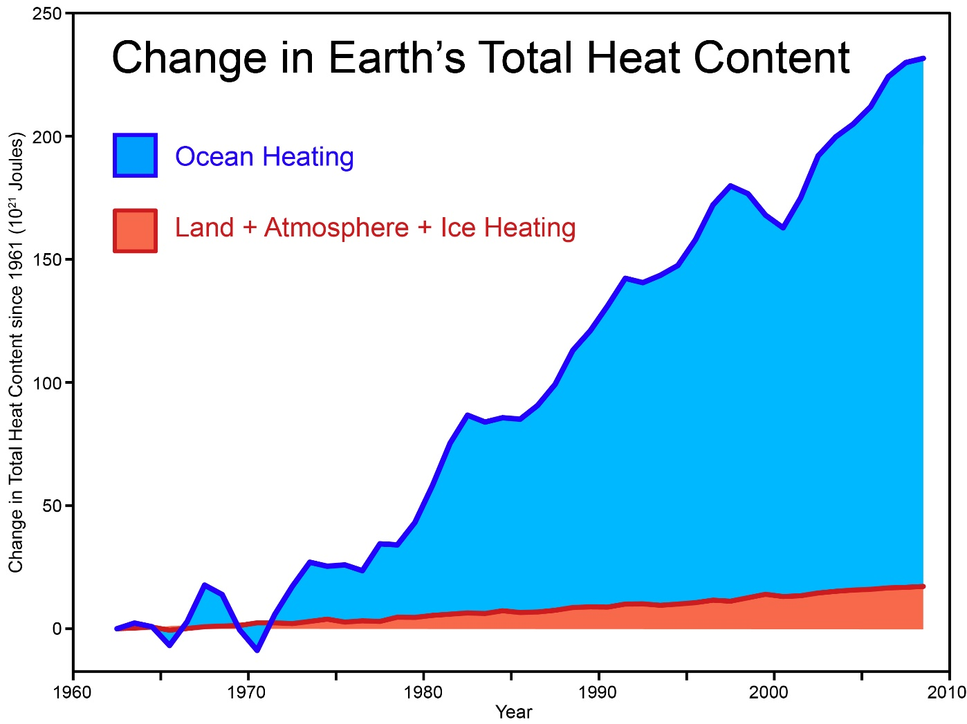
WHAT WE ARE MAKING OF OUR FUTURE
Notes:
As you see we were killing future. The content of heat has been drastically increasing on earth since 1960. There is nothing new about climate change. For hundreds of millions of years the Earth’s temperature has been influenced by continental shifts, which have triggered volcanic eruptions among other things. Sometimes these shifts released large volumes of CO2 which heated up the Earth. They also caused young rocks to rise to the surface, which chemically bound CO2. As a result, CO2 was dispelled from the atmosphere in the longer term.

Slide 6

WHO IS RESPONSIBLE?
Humans have been influencing the climate since the start of the Industrial Revolution. Since then, the average world temperature has risen by approximately 0.8 degrees Celsius. In North-West Europe (including the Netherlands) the average temperature has risen by 1.5 degrees. The sea level has risen by around twenty centimetres and most of the glaciers have shrunk dramatically. Up to 1950 the influence of nature was more important than human influence. After that, the pattern in the average world temperature can only be explained by factoring in the human influence.
Notes:
Humans have been influencing the climate since the start of the Industrial Revolution. Since then, the average world temperature has risen by approximately 0.8 degrees Celsius. In North-West Europe (including the Netherlands) the average temperature has risen by 1.5 degrees. The sea level has risen by around twenty centimetres and most of the glaciers have shrunk dramatically. Up to 1950 the influence of nature was more important than human influence. After that, the pattern in the average world temperature can only be explained by factoring in the human influence.

Slide 7
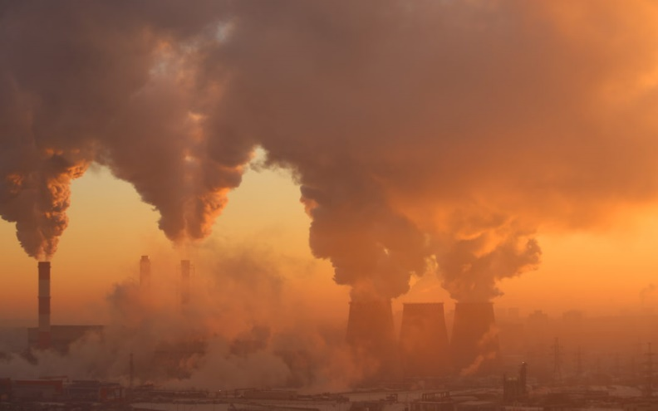
Notes:
The content of the pollution on the earth atmosphere is on extreme. It is all on our heads. Even so, a slight decline in temperature did appear from the mid-1940s to the mid-1970s. It was linked to a dramatic increase in cooling aerosols from the post-war industrialisation in the western world. It was also caused by a mild decline in solar activity and some major volcanic eruptions in the second half of this period.
According to the latest IPCC (Intergovernmental Panel on Climate Change) report, it is more than likely (more than 90 per cent probability) that most of the global warming in recent decades is attributable to the observed increase in greenhouse gases.

Slide 8
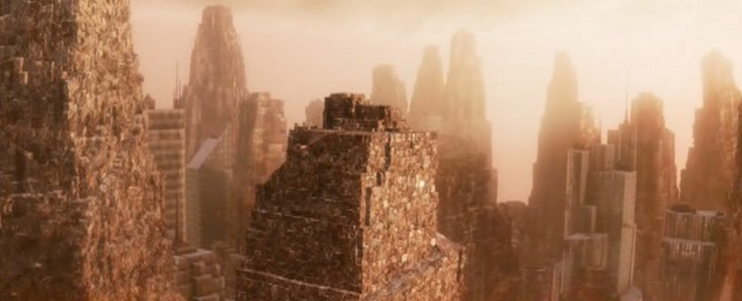
Notes:
Sooner than late, at the rate of pollution that we currently have on earth, we will have cities of garbage for sky capers. Other than distorting the earth it poisons the atmosphere even more. The disposal and treatment of waste can produce emissions of several greenhouse gases (GHGs), which contribute to global climate change. The most significant GHG gas produced from waste is methane. It is released during the breakdown of organic matter in landfills. Other forms of waste disposal also produce GHGs but these are mainly in the form of carbon dioxide (a less powerful GHG). Even the recycling of waste produces some emissions (although these are offset by the reduction in fossil fuels that would be required to obtain new raw materials)

Slide 9
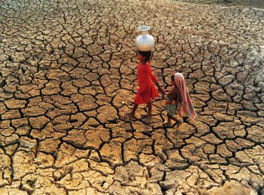
Notes:
Even as we speak, the challenge of draught resulting from global warming and increased temperature levels affect more than half the population on earth.

Slide 10
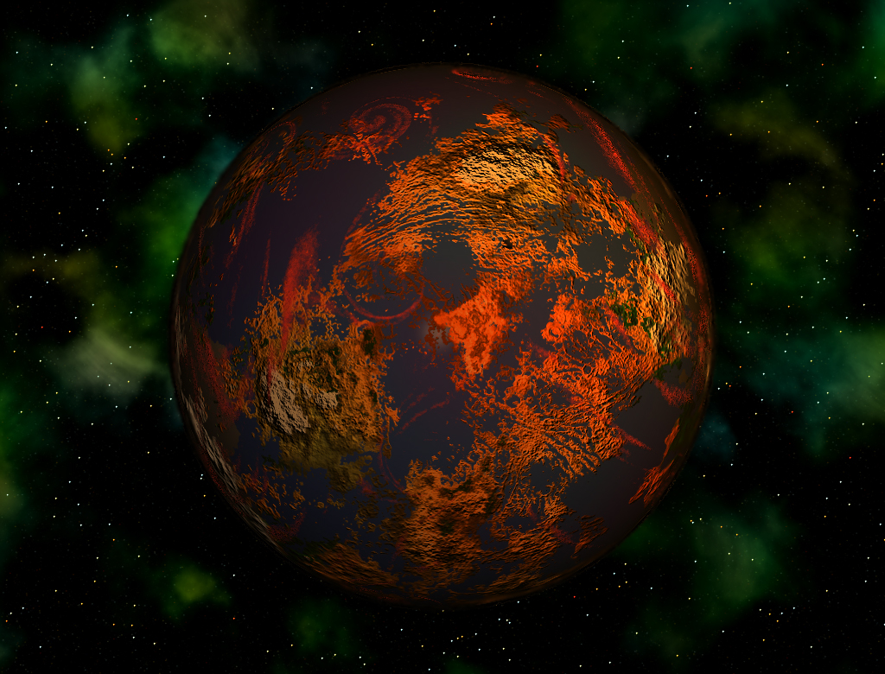
Notes:
If we do not change and adapt to greener living our beautiful blue earth will not be the same any more.

Slide 11
References
Jones, P. D., Trenberth, K. E., Ambenje, P., Bojariu, R., Easterling, D., Klein, T., ... & Soden, B. (2007). Observations: surface and atmospheric climate change. Climate change, 235-336.
Change, I. P. O. C. (2014). IPCC. Climate change.
Intergovernmental Panel on Climate Change. (2015). Climate change 2014: Mitigation of climate change (Vol. 3). Cambridge University Press.
Change, I. P. O. C. (2007). Climate change 2007: The physical science basis. Agenda, 6(07), 333.
Change, C. (2016). What Climate Change.

